Slide 1
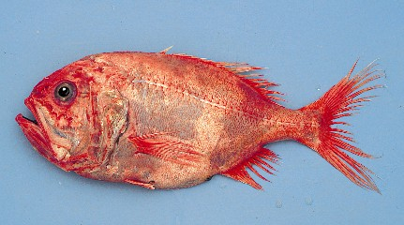
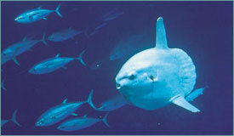
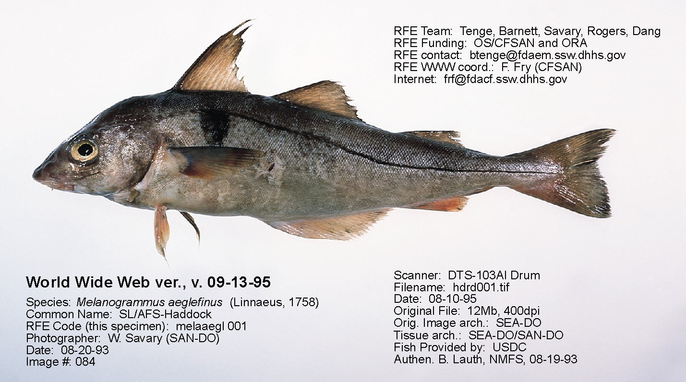
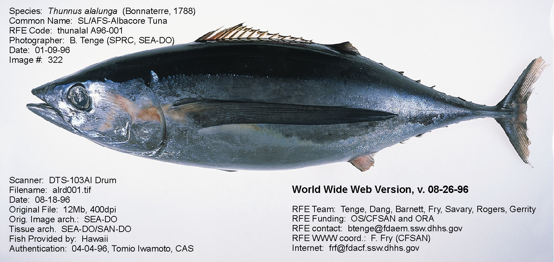
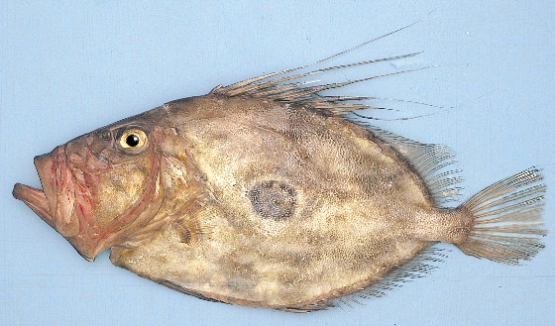
Nekton – adaptations, populations & communities

Slide 2
How can 26k spp. of fish coexist in a ‘homogeneous’ habitat?
50% of vertebrate species
Why is this coexistence a puzzle?
Competitive exclusion principle
“Law” of limiting similarity
Different niches

Slide 3
Characteristics of Bony Fishes (Osteichthyes)
Skeleton more or less bony; tail usually homocercal
Fins both median & paired with fin rays of cartilage or bone
Mouth terminal
Respiration by gills supported by bony gill arches & covered by a common operculum
Swim bladder often present with or without duct connected to pharynx

Slide 4
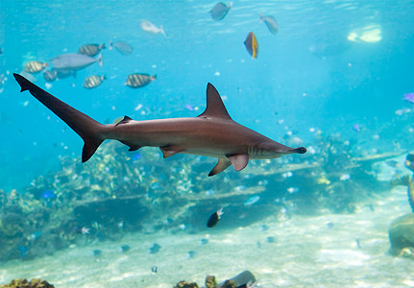
Characteristics of Cartilaginous Fishes (Chondrichthyes)
Body fusiform (except rays) with a heterocercal caudal fin
Mouth ventral
Skin with placoid scales
Endoskeleton entirely cartilaginous
Respiration by means of 5 to 7 pairs of gills with separate and exposed gill slits, no operculum
No swim bladder or lung

Slide 5
Adaptations of Oceanic Nekton
Buoyancy
Gas or swim bladder (possessed by most fishes)
Two types of gas bladder
Physostome: Open duct exists b/w gas bladder & esophagus (e.g. Herrings, salmonids, catfishes)
Physoclist: No duct is present (spiny-rayed fishes)

Slide 6
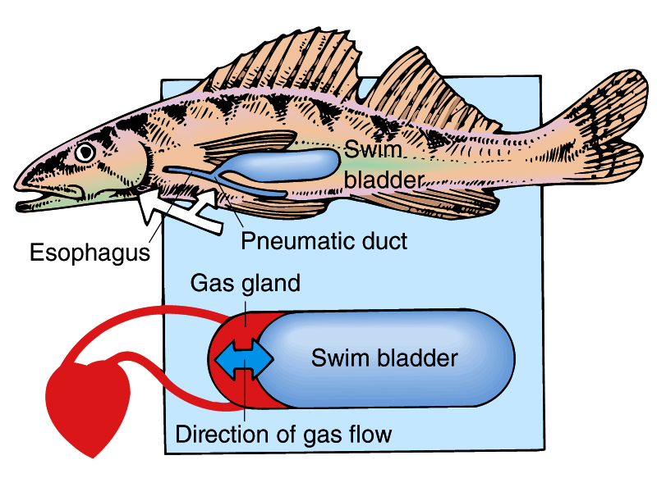
Physostomous Fish

Slide 7
Adaptations of Oceanic Nekton contd.
Buoyancy contd.
Gas-filled cavities (lungs) --- in air-breathing nektonic animals
Accessory air sacs (in some marine mammals; birds)
Air trapped under feathers (penguins)
Air trapped in dense wool undercoats (sea otters & fur seals)

Slide 8
Adaptations of Oceanic Nekton contd.
Buoyancy contd.
Replacement of heavy chemical ions (Na⁺) in the body fluids with lighter ones (NH4⁺) --- in squids
Lay down lipid (fat or oil) in the body---in fishes (muscles, liver, etc), marine mammals (below the skin as blubber)

Slide 9
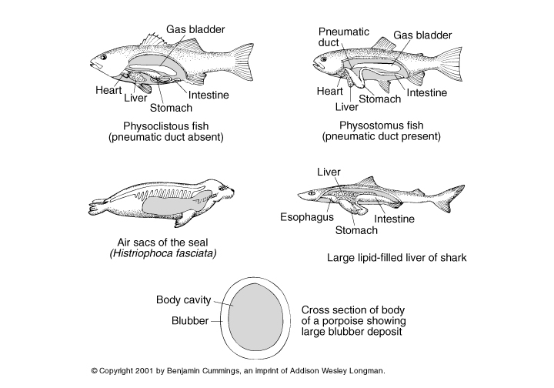
Buoyancy adaptations of nektonic fishes and mammals

Slide 10
Adaptations of Oceanic Nekton contd.
Buoyancy contd.
Hydrodynamic mechanisms for producing buoyancy during movement
Lifting surfaces in the anterior region (pectoral fins, flippers)
Heterocercal tail (upper lope is larger than lower lobe)
More primitive fishes tend to have hydrodynamic adaptations to create lift
More advanced fishes appear to evolve static or passive means to achieve neutral buoyancy

Slide 11
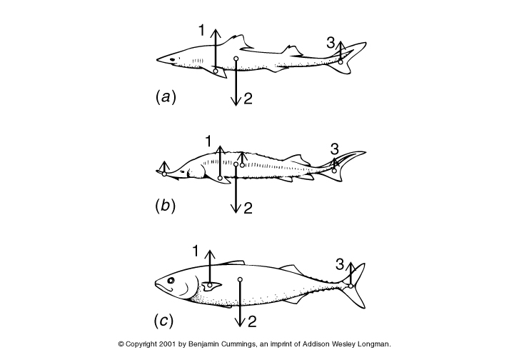
Various Tail and Fin Shapes in Fishes Showing the Lift Provided
Force by Pectoral fins
Force due to residual wt.
Force provided by caudal fin

Slide 12
Adaptation to Locomotion
Adaptation to create propulsive force
Undulation of the body from side to side due to alternate contractions of the body muscles (fishes)
Tail movement are up and down in whales
Undulation of the fins: body remains stationary while fins are moved to effect forward motion

Slide 13
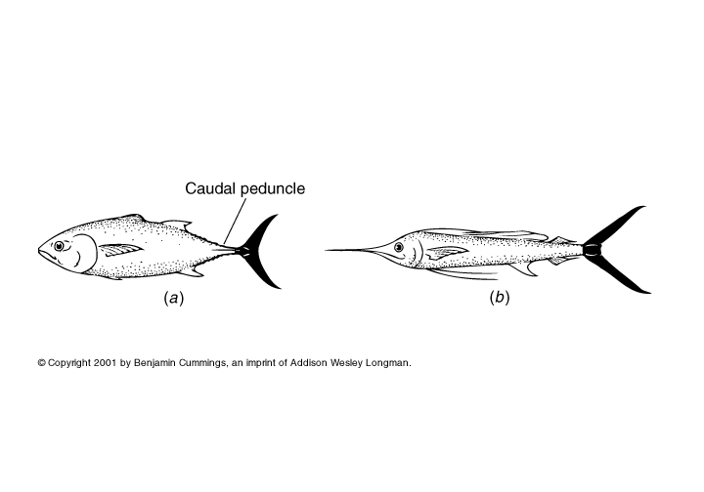
Fast swimming fishes with the characteristic lunate tail and narrow peduncle
Tuna
Sailfish

Slide 14
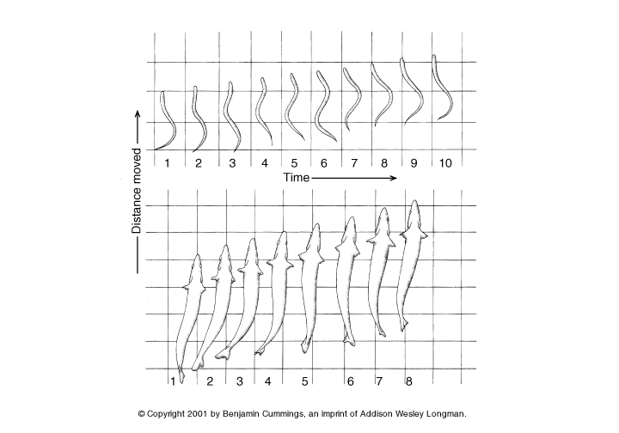
Propulsion in an elongated fish and a stubby fish
Slower
Faster

Slide 15
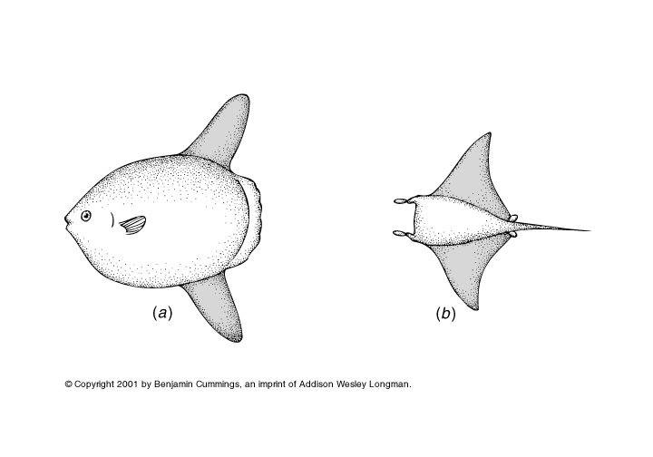
Fishes using fins for locomotion
Ocean Sunfish
Manta ray

Slide 16
Surface of Resistance and Body Shape
Three Types of Resistance to Movement:
Frictional Resistance: Drag is proportional to the amount of surface area in contact with the water
Form Resistance: Drag is proportional to the cross-sectional area of the object in contact with the water
Induced Drag (Turbulence): Flow around small animals or slow, large ones is usually smooth (laminar flow); laminar flow is disrupted with increasing speed forming vortices & eddies thereby increasing drag; streamlined bodies (e.g. whales, dolphins, tunas) provide the lowest resistance

Slide 17
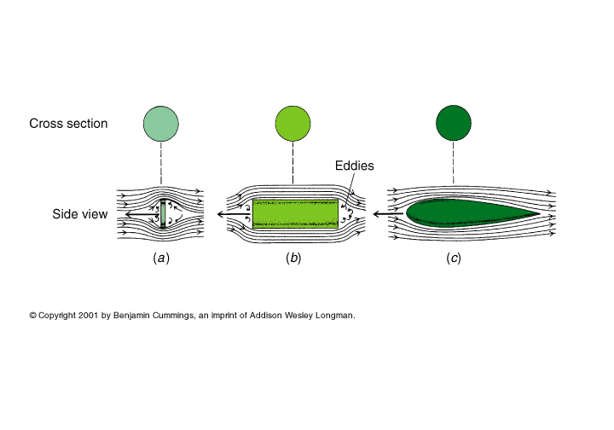
Drag forces on variously shaped objects moving through water
A flat Disk
A Cylinder
A teardrop-shaped object

Slide 18
Streamlined Body (e.g. Tuna)
Most normally protruding body structures (e.g. pectoral & pelvic fins) are recessed into depressions or grooves from which they may be elevated when needed
Eyes do not protrude beyond the sides of the body
Body scales are reduced or absent
In marine mammals, hair is lost or reduced in length; mammary glands are flattened.

Slide 19
Defense and Camouflage
Large size: Most have few predators
Camouflage:
Cryptic Body Shape (alteration of body shape)
Development of a ventral keel (median longitudinal ventral ridge) to the body of nektonic fishes (helps to eliminate a conspicuous shadow on the belly of the animal when viewed from below)
Cryptic Coloration: a) Countershading-Dark blue or green color on dorsal surfaces to match blueish or greenish color of lighted upper waters of the Ocean; white or silver color on the ventral surface b) Complex color patterns (e.g. in Porpoises) with irregular bands of light & dark that mimic pattern of wave-roughened surface waters.
Large Pectoral Fins: In flying fishes-used to propel out of water & glide for long distances

Slide 20
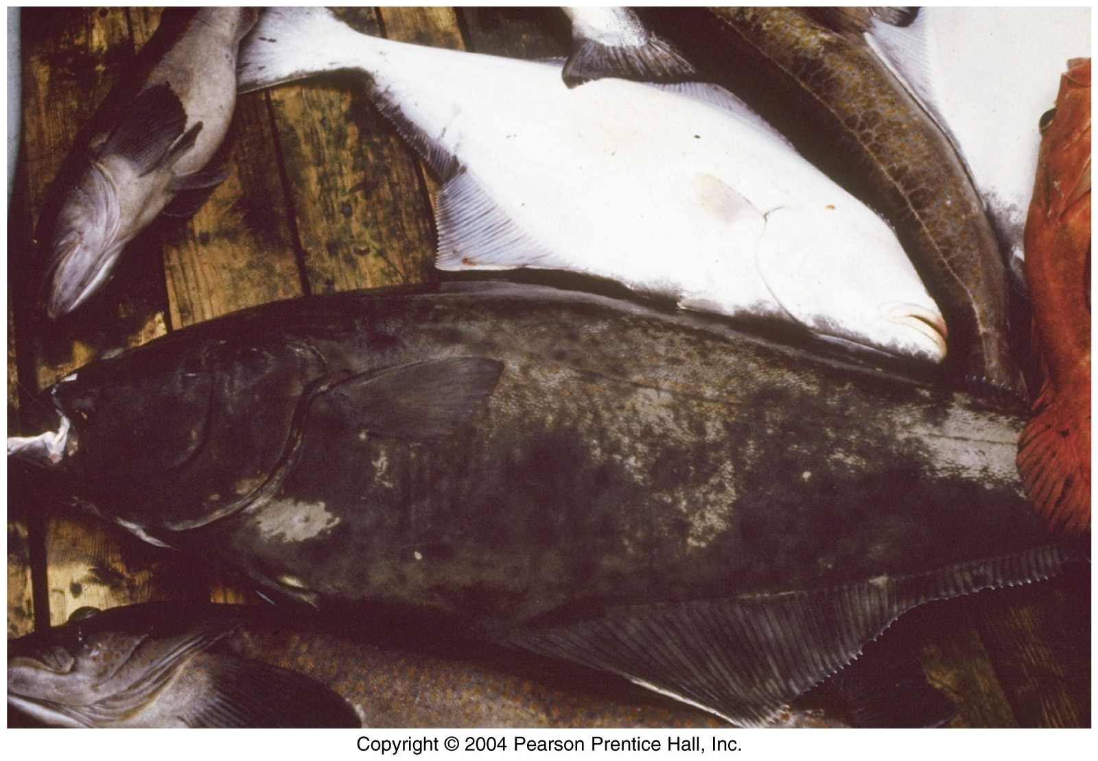
Countershading: Halibut

Slide 21
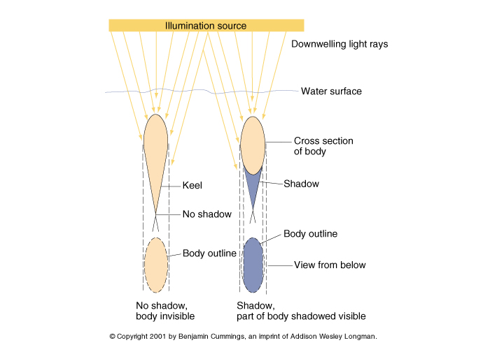
Diagram Showing how Keel on the ventral surface of an animal eliminates the dark shadow normally cast downward by an unkeeled animal

Slide 22
Adaptations to avoid being prey
Speed, poisonous secretions, mimicry of other poisonous or distasteful species, camouflage, countershading, transparency
Schooling
Many individuals maneuver as if one
Safety in numbers
Appears larger
Movements confusing to predator

Slide 23
Sensory Systems
Are well developed in nekton
Lateral Line System in Fishes: rows of tubes open to the surface; contain sensory pits sensitive to pressure changes in water
Ampullae of Lorenzini in Sharks & Rays: Sensitive to minute electric currents in water; use electroreception to find prey
Geomagnetic sensory system in marine mammals for long-distance navigation
Eyes: Well developed
Olfactory senses (sense chemicals)
Hearing senses (Inner Ear in fishes)

Slide 24
Feeding Ecology and Food Webs of Marine Nekton
Adult nekton are carnivores preying on smaller plankton or other nekton
Plankton feeders (e.g. flying fish, sardines, baleen whales) consume the larger zooplankton
Baleen whales (e.g. blue whale) lack teeth but instead use sheets of baleen (whalebone) to seive zooplankton (krill) from water
Dominant zooplankton consumed by planktivorous fish include krill, copepods, amphipods.
Type of zooplankton consumed varies spatially and seasonally which may be due to competition for food.
A large number of small fishes that live in the mesopelagic zone are planktivores & do migrate into the epipelagic zone at night to feed.

Slide 25
How can we characterize food webs?
Dominant taxa
Complexity
Number of links
Number of “levels” (and degree of isolation)
Influence of indirect interactions
Productivity/biomass at base
Rate of flow of energy/mass
Degree of fluctuation (seasonal, annual, decadal scales of time)
Resilience (recovery from disturbance)
Degree of isolation/openness (spatial scale)

Slide 26
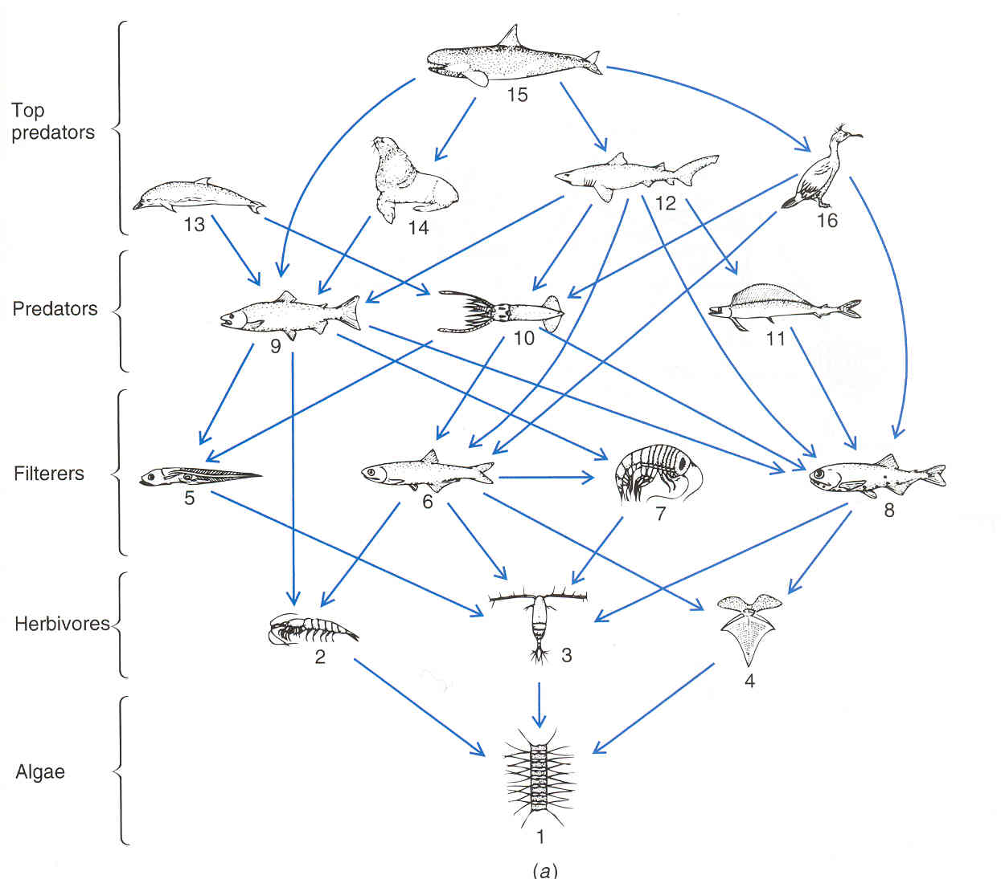
Food webs, high latitudes

Slide 27
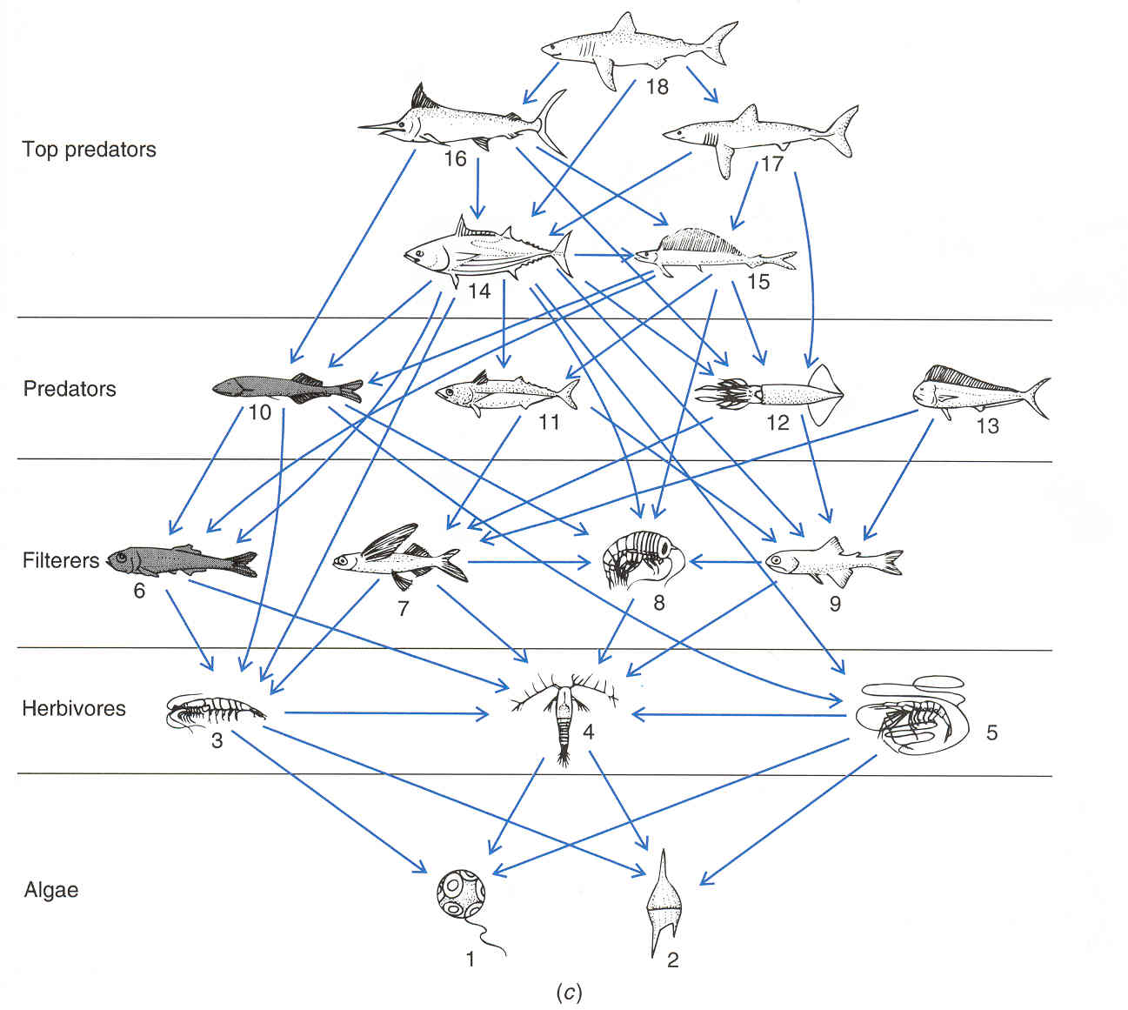
Food webs, tropical latitudes

Slide 28
What is a “population” of tuna?
How do we define “population”?
spatial component
reproductive component
in fisheries, “stock” is a synonym
Why do we want to know the size & distribution of populations?
What criteria can be applied to delimit populations of oceanic nekton?

Slide 29
What do we need to know?
What influences nekton abundance?
Bottom-up influences
Intrinsic (physiological) influences
Top-down influences
How important are community-level interactions?

Slide 30
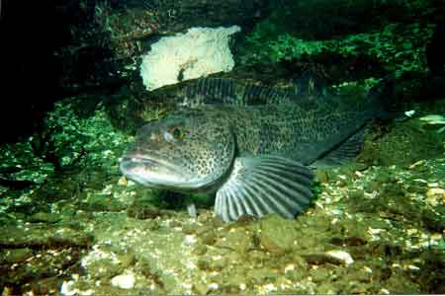
Ling cod

Slide 31
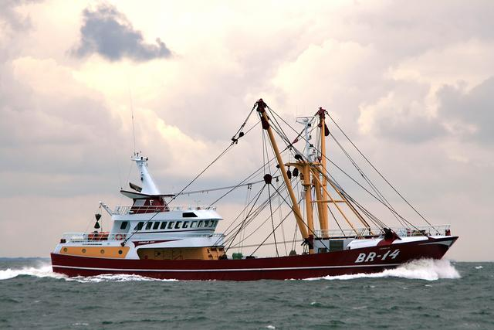
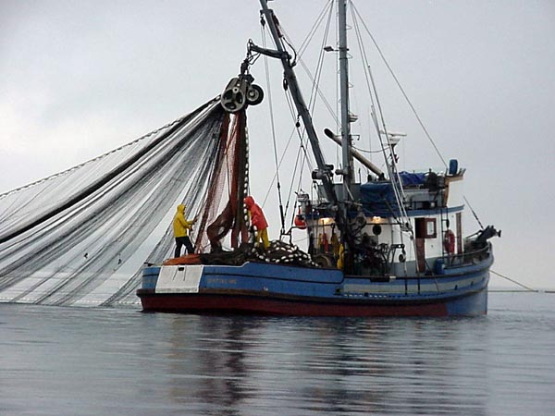
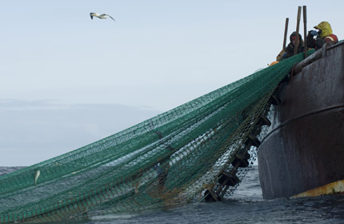
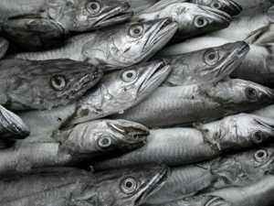

Slide 32
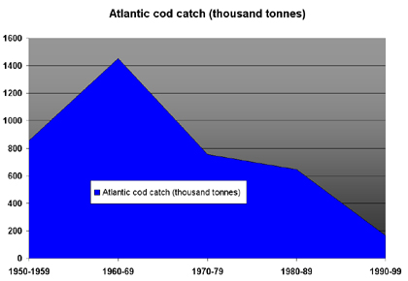

Slide 33
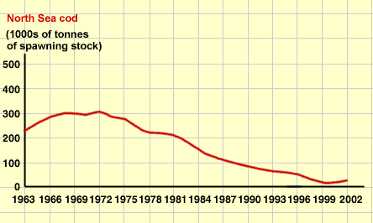

Slide 34
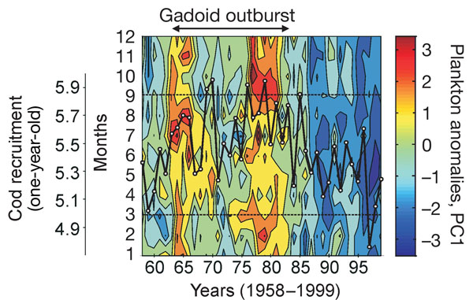
Plankton effect on cod recruitment: Beaugrand et al., 2003, Nature 427:661
Long-term monthly changes (1958–1999) in the plankton index and cod recruitment.

Slide 35
Trends in phytoplankton and cod success

Slide 36
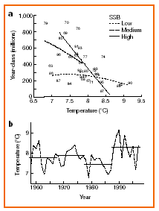
O’Brien et al., Nature 404: 142
“Climate variability and North Sea cod”

Slide 37
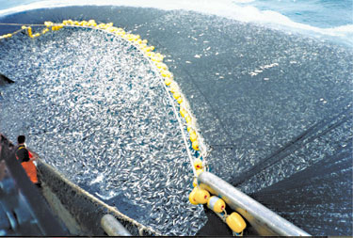

Slide 38
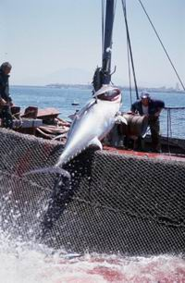
Long-line fishing

Slide 39
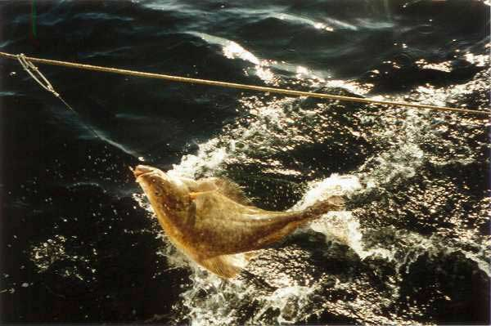
Halibut on long line

Slide 40
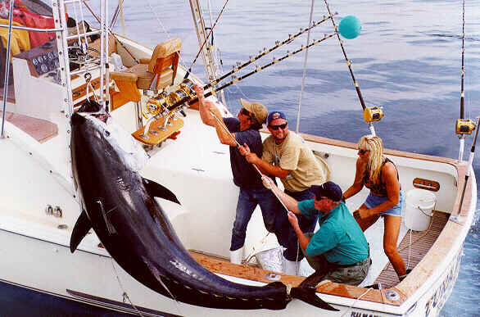
Sport fishing – 900 lb tuna

Slide 41
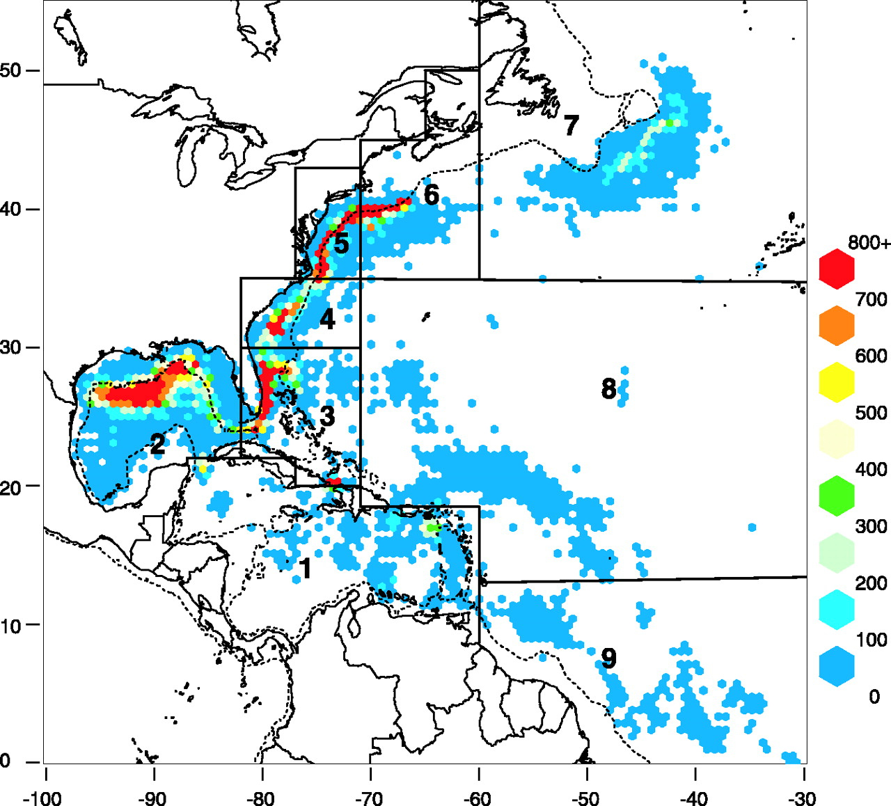
Intensity of long-line fishing, 1986-2000 Baum et al., Science 299:389

Slide 42
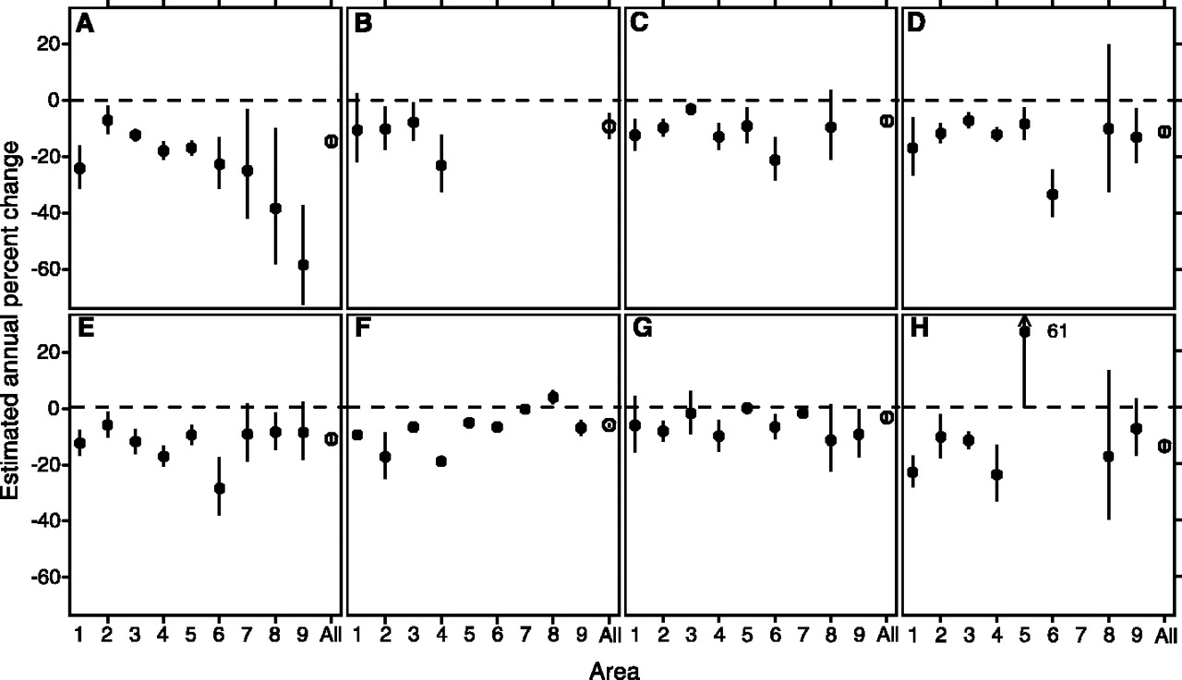
The estimated annual rate of change, in each area ( ± 95% CI) and in all areas combined ( ± 95% CI), for coastal shark species: (A) hammerhead, (B) white, (C) tiger, and (D) coastal shark species identified from 1992 onward; and oceanic shark species: (E) thresher, (F) blue, (G) mako, and (H) oceanic whitetip.

Slide 43
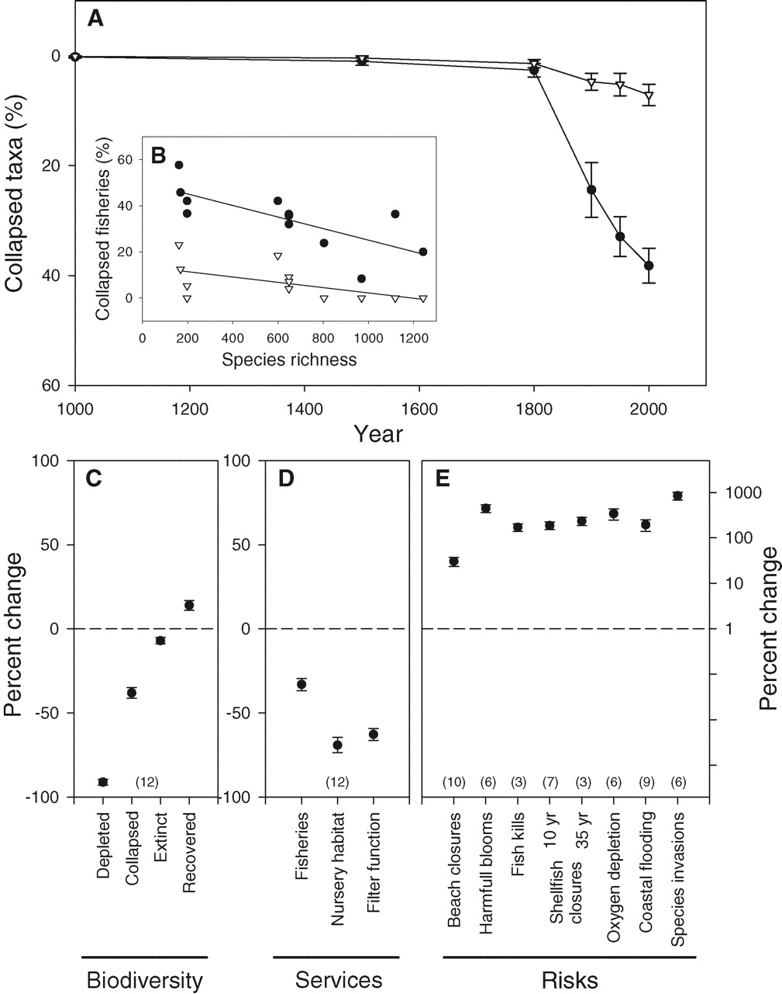
Fig. 2. Regional loss of species diversity and ecosystem services in coastal oceans
B. Worm et al., Science 314, 787 -790 (2006)
Published by AAAS

Slide 44
How might physiological influences affect nekton abundance?
Growth rates may be temperature dependent
Size influences
feeding success
the number of eggs produced per female
“escape” from smaller predators through growing too large to be eaten
Is there evidence for temperature effects on nekton success?

