Slide 1
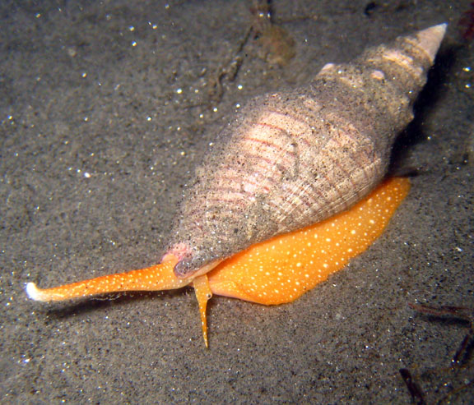

Slide 2
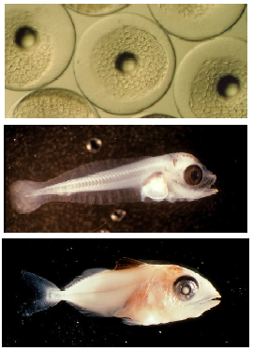
Demographic or ecosystem management?

Slide 3
What is a “population” of a fish species?
How do we define “population”?
spatial component
reproductive component
in fisheries, “stock” is a synonym
Why do we want to know the size & distribution of populations?
What criteria can be applied to delimit populations of oceanic nekton?

Slide 4
What do we need to know?
What influences nekton abundance?
Bottom-up influences
Intrinsic (physiological) influences
Top-down influences
How important are community-level interactions?

Slide 5
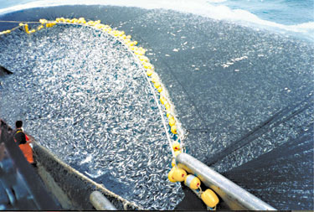
Methods of Harvesting: Purse Seine

Slide 6
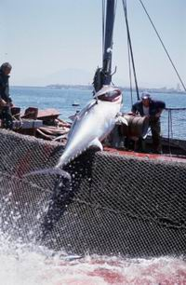
Long-line fishing

Slide 7
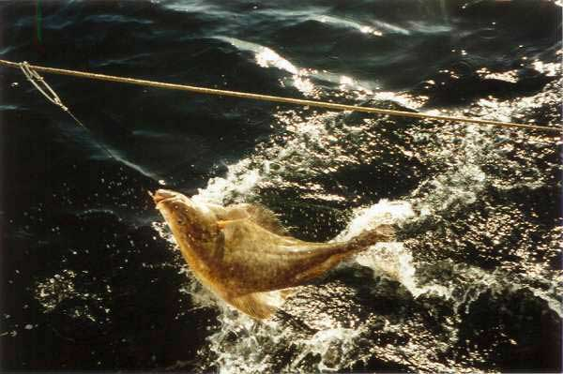
Halibut on long line

Slide 8
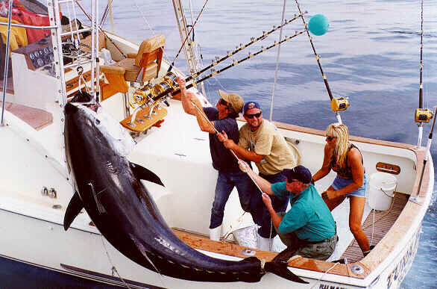
Sport fishing – 900 lb tuna

Slide 9
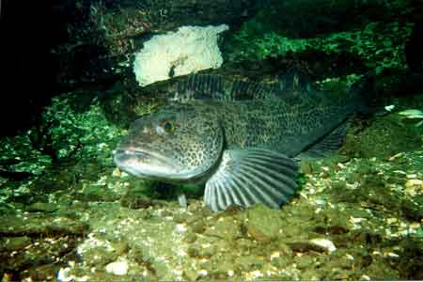
Ling cod

Slide 10
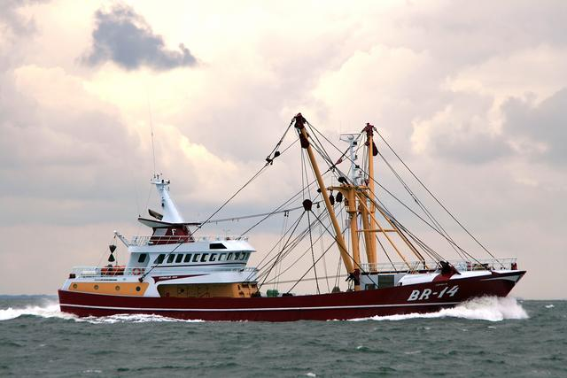
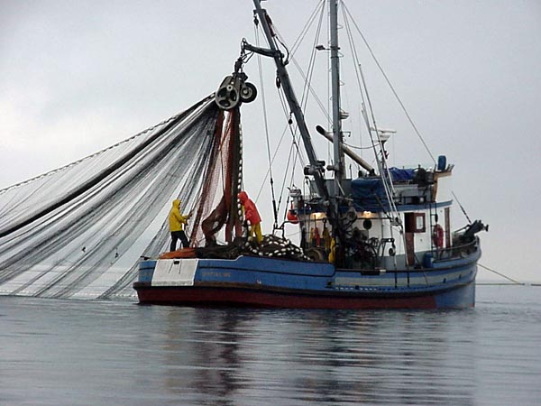
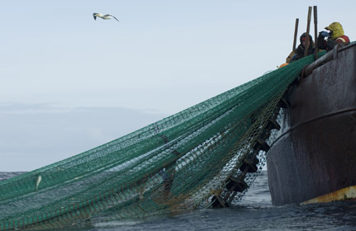
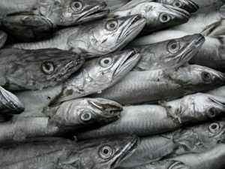
Otter Trawl

Slide 11
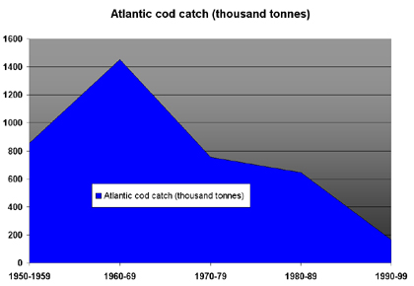

Slide 12
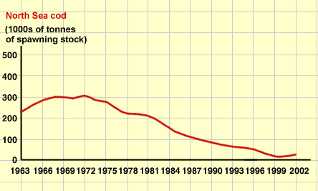

Slide 13
Why do nekton populations change?
Natural cycles
Trophic interactions (food, predators, disease)
Direct harvest
Habitat disruption
Climate change

Slide 14
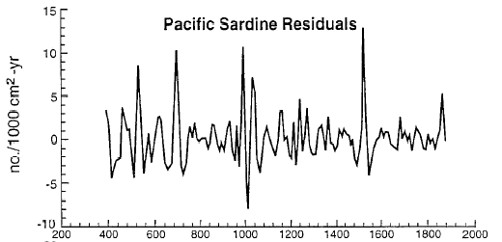
I. Natural fluctuations
Deposition of scales
Populations are not necessarily constant in the absence of human influence
Examples of naturally occurring cycles of environmental conditions?
Different scales of geographic extent
Different scales over time
e.g., large scale cycle ENSO

Slide 15
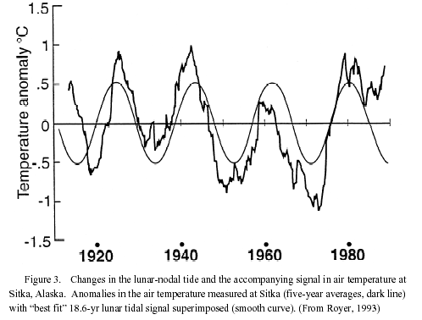
Cyclic environmental fluctuations

Slide 16
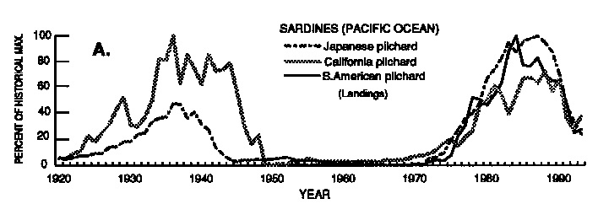
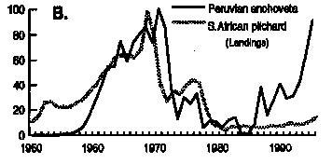
Fluctuations in fish populations with ENSO

Slide 17
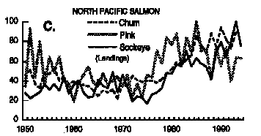
Fish species react differently to ENSO
Anchovy & sardine cycle out of phase
Differences in habitat (sardines more offshore, deeper)
This impacts natural food webs

Slide 18
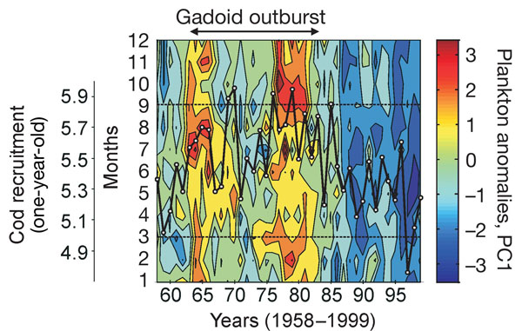
Plankton effect on cod recruitment: Beaugrand et al., 2003, Nature 427:661
Long-term monthly changes (1958–1999) in the plankton index and cod recruitment.

Slide 19
Trends in phytoplankton and cod success

Slide 20
How do we predict a “sustainable harvest”?
And what about effects on non-target species = “bycatch”?

Slide 21
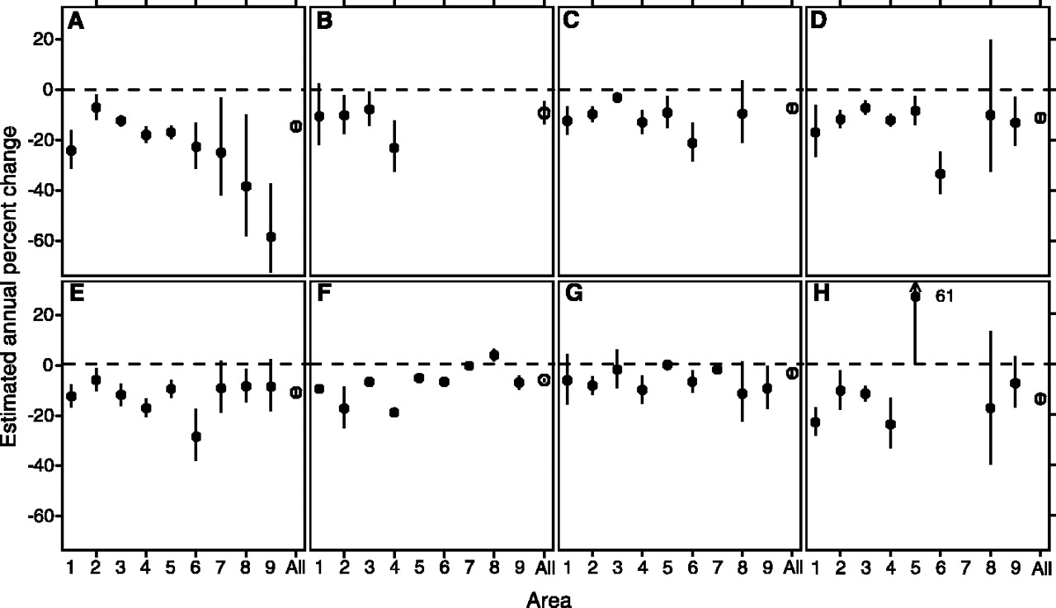
The estimated annual rate of change, in each area ( ± 95% CI) and in all areas combined ( ± 95% CI), for coastal shark species: (A) hammerhead, (B) white, (C) tiger, and (D) coastal shark species identified from 1992 onward; and oceanic shark species: (E) thresher, (F) blue, (G) mako, and (H) oceanic whitetip.

