Slide 1
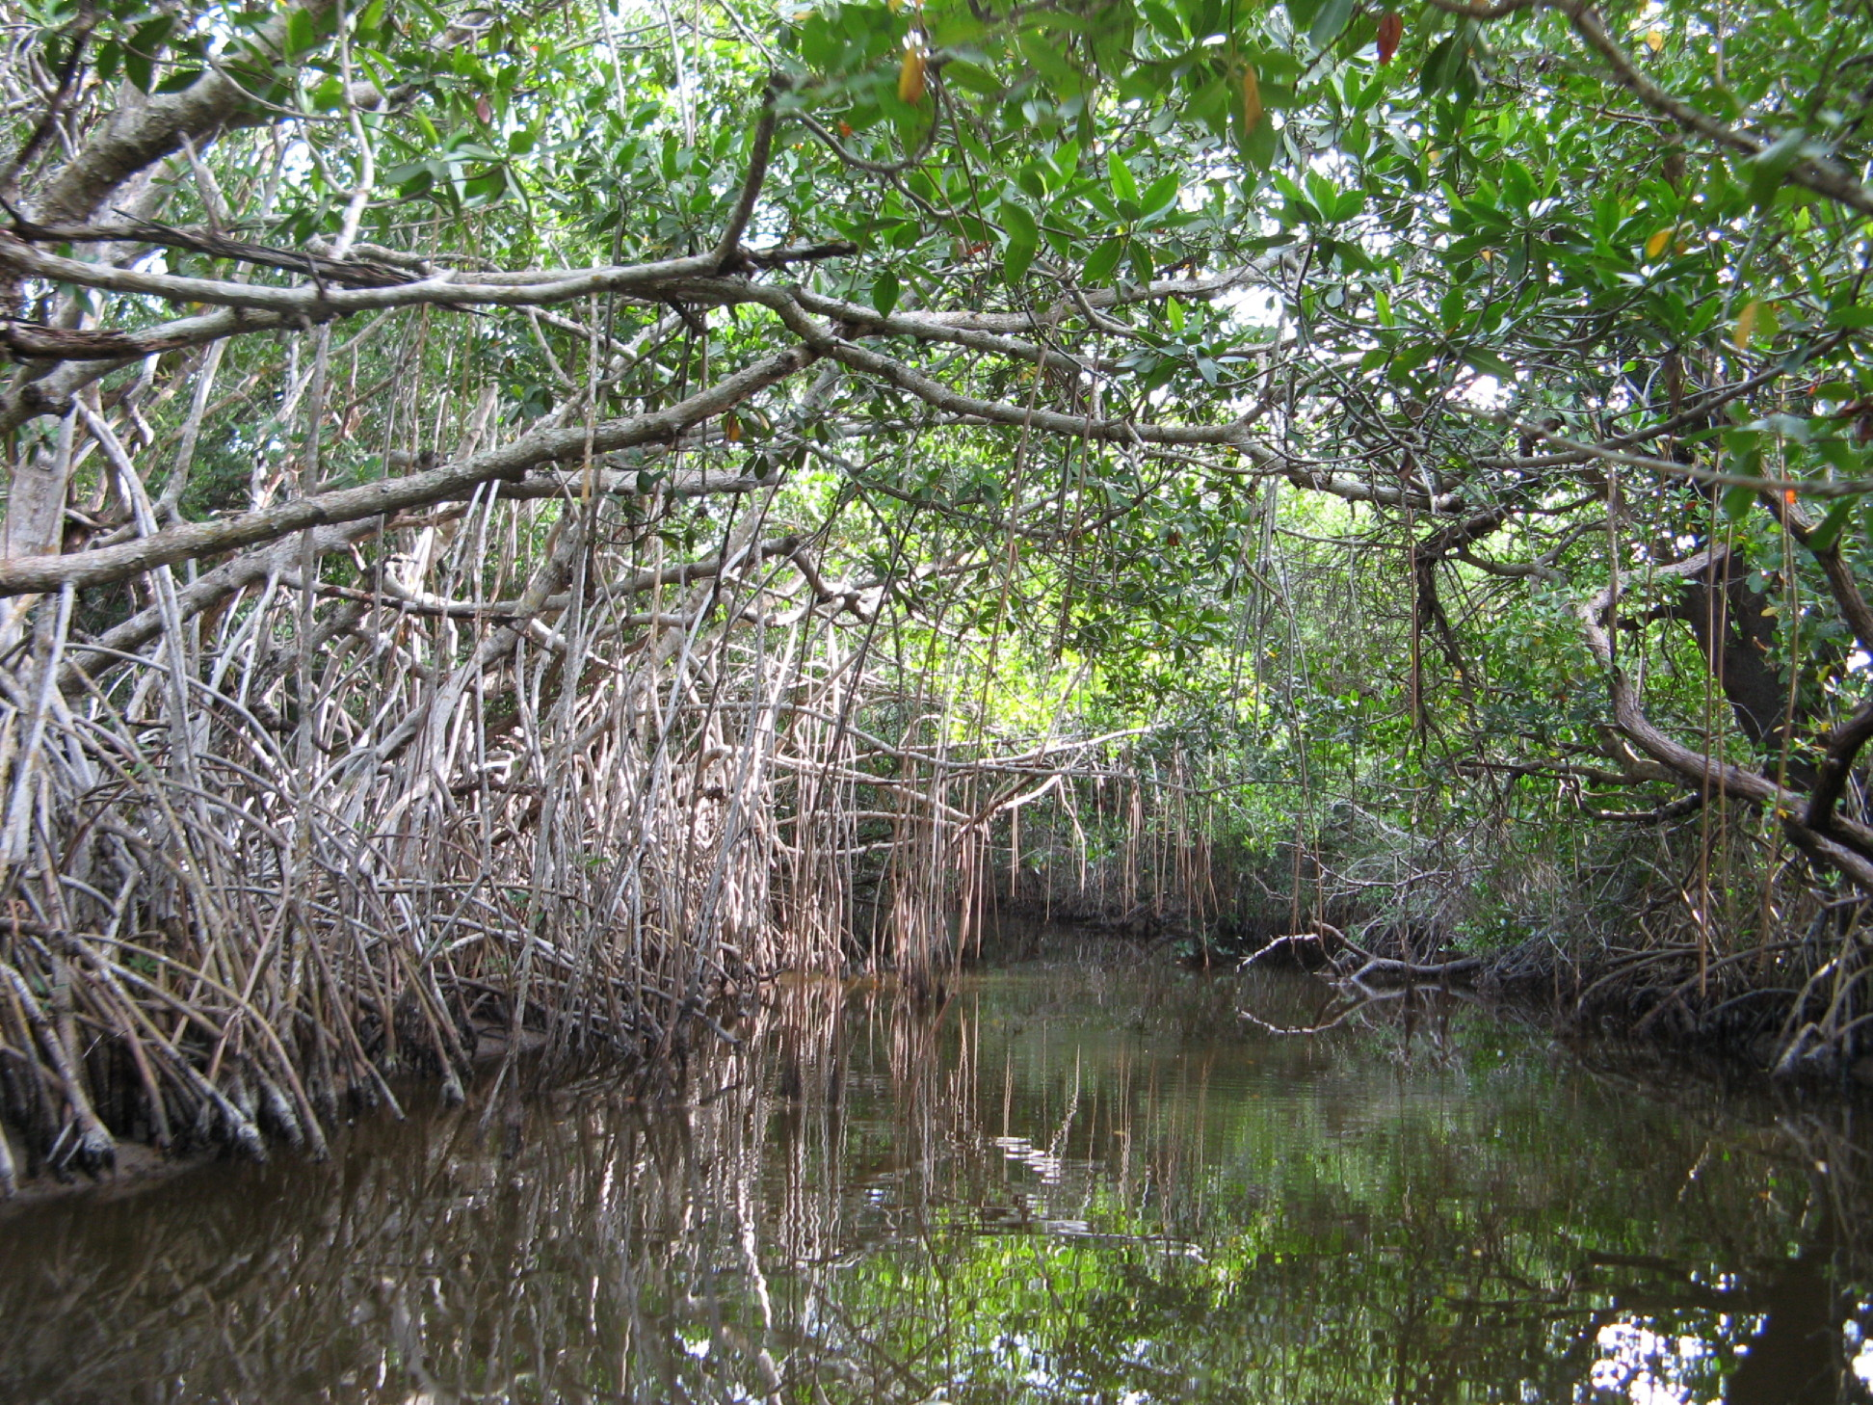
Mangrove /Mangal
Values

Slide 2
Mangal variation falls into 3 categories
Basin Mangrove
Extensive, low energy
Shallow estuary
Riverine Mangrove
Somewhat linear, subject to flooding
Highly variable salinity
Fringing Mangrove
Linear & narrow, along coastal shores
Oceanic salinity; exposed to storm surges

Slide 3
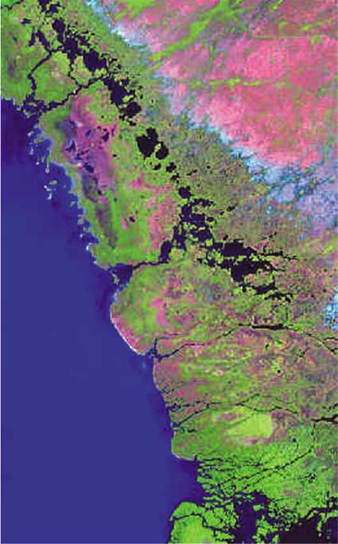
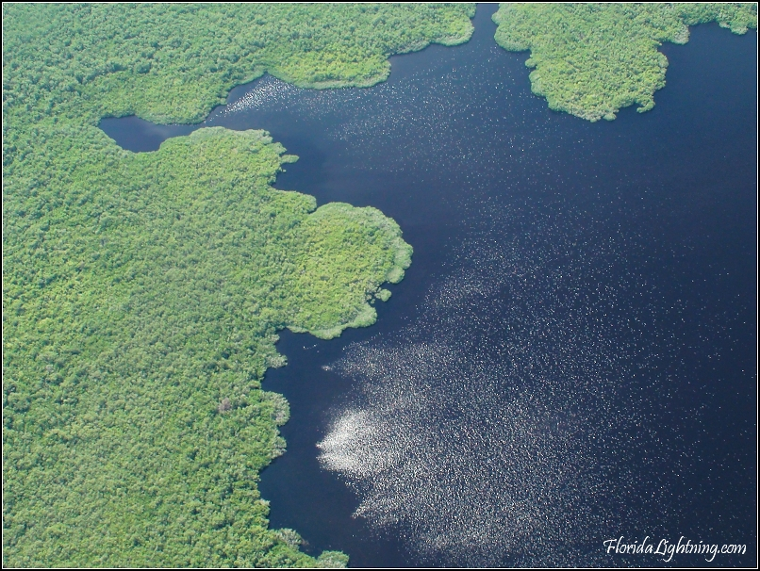
Basin Mangrove

Slide 4
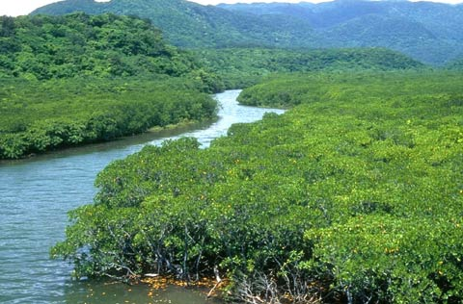
Riverine Mangrove

Slide 5
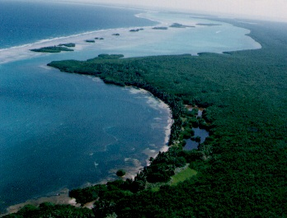
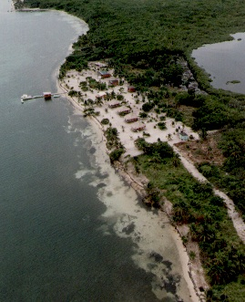
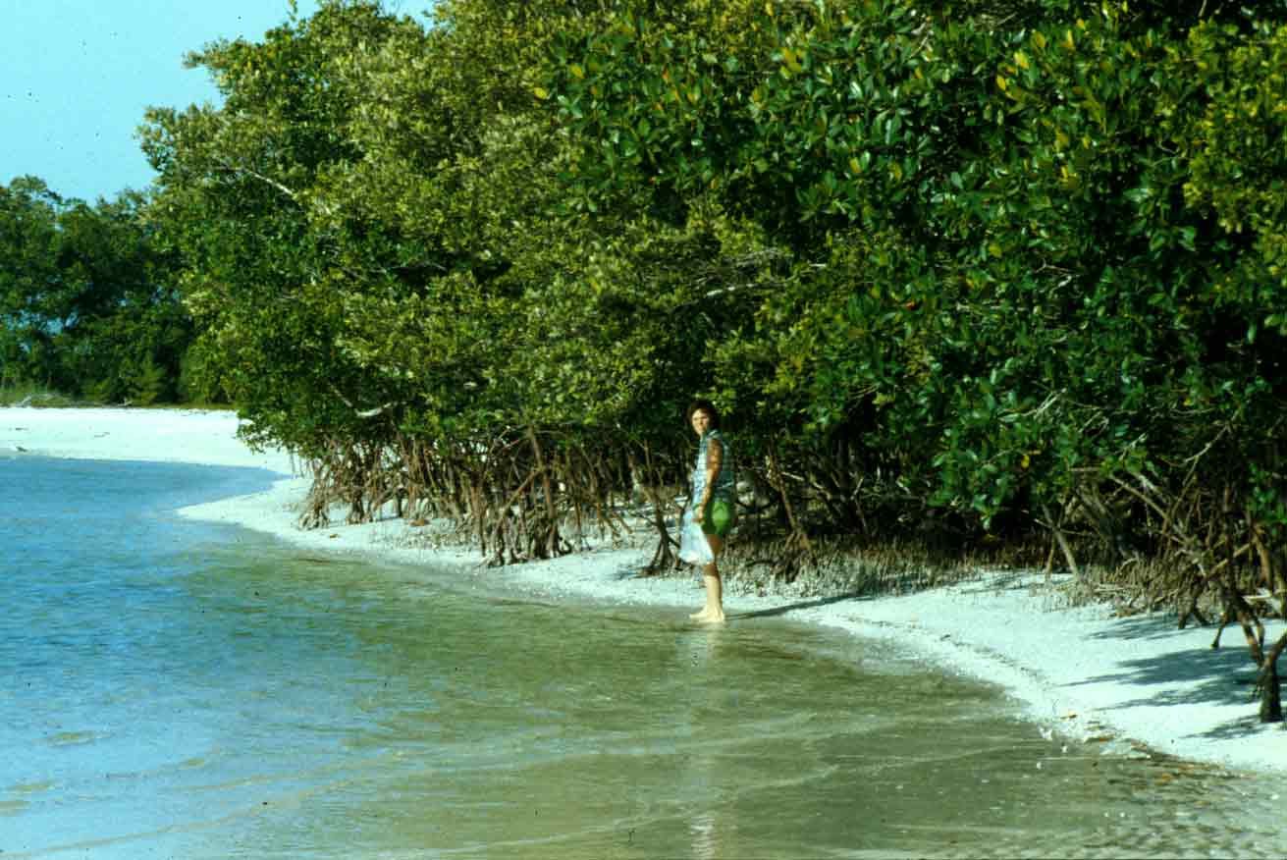
Fringing Mangrove

Slide 6
Big Questions:
Do mangroves subsidize (with nutrients) adjacent ecosystems in the habitat mosaic?
Are mangroves nursery habitats for adjacent ecosystems?
Do mangroves protect coastal (human) populations?

