Slide 1
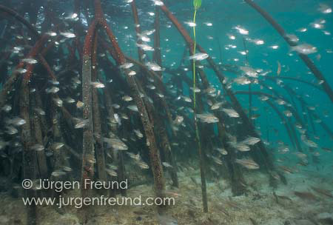
Mangove/Mangal
Nursery & Protective Values

Slide 2
What is a nursery?
Historically
An area that supports a higher density or abundance of immature fishes than other, adjacent habitats.
But this can be caused just by area effects
More operational definition:
An area where its production of a cohort is higher (per unit area) than other, adjacent habitats

Slide 3
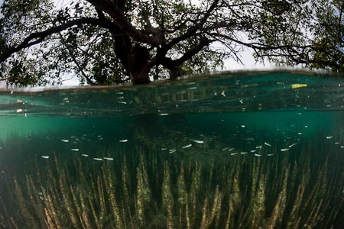
Elements of a nursery
Density of juveniles - numbers
Growth rates of juveniles
Differential mortality of juveniles
Export of juveniles to adult populations in adjacent habitats

Slide 4
Are mangal ecosstems nurseries?
It depends
“It is time that we biologists accept diversity and variability for what they are, two of the essential features of the natural world. … “Variation among and within species is fundamental to organisms.”
Bartholomew 1986

Slide 5
Variation in how fish utilize mangal
Numbers of larvae added to mangal vs. other habitats
Spawning behavior
Offshore w/ small % movement in (most snappers in Caribbean) – affected by gyres
Mangrove snapper – inside mangal (high %)
Shallow basins favor mangal spawning

Slide 6
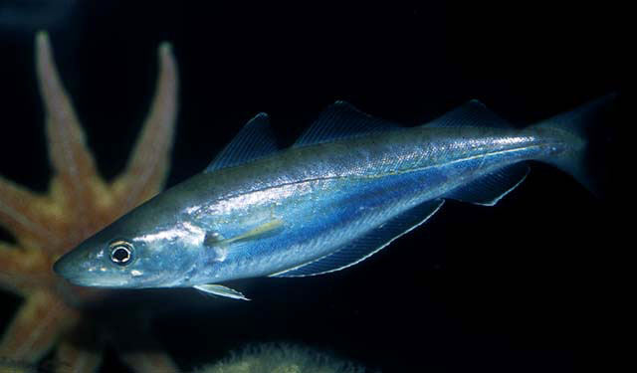
Variation in growth rates
Little direct evidence
Ontogenetic shifts of some species suggest that juveniles get something special in mangal
Some species of whiting (Australia)
Fish size
FL – higher in
mangrove than in
seagrass

Slide 7
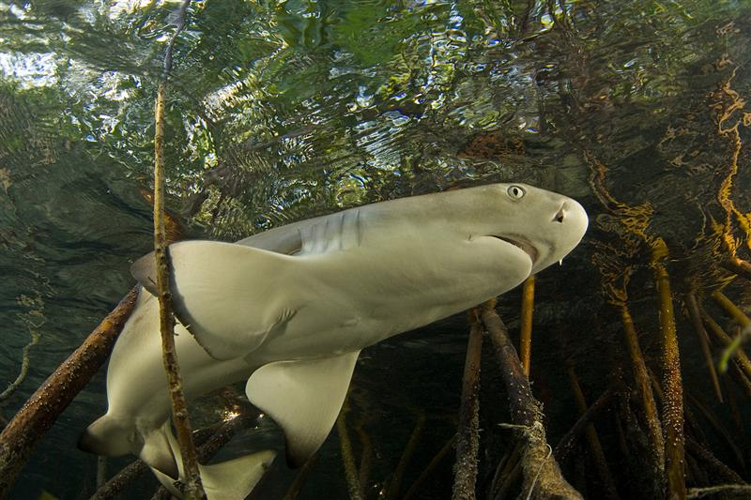
Is mortality reduced?
Day-night migration patterns near sea-grass
Experiments with exclosures, food enrichment

Slide 8
What influences variation in export?
Proximity to other habitats varies
Seagrass
Coral reef
Sand or mud benthic habitats
Studies of faunal overlap
Suggest more overlap in Atlantic than Indo-Pacific regions
Studies of population density near mangal
Positive correlations w/ proximity in Shark Bay

Slide 9
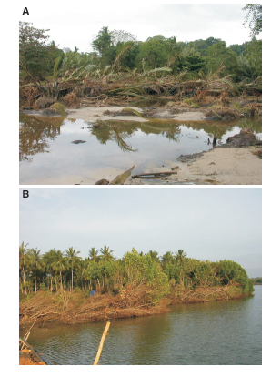
Do mangroves protect coastal ecosystems?
2004 Dec 26 Tsunami – Indonesia, Sri Lanka

Slide 10
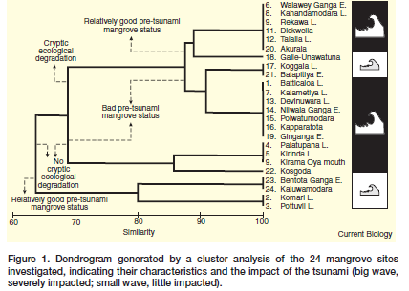
Mangrove status & wave size
Current Biology 15(12) 443-447

Slide 11
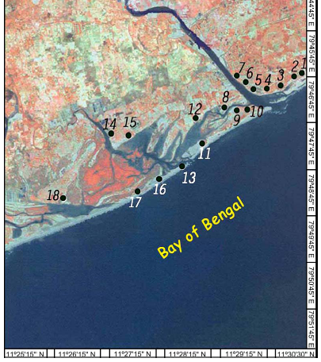
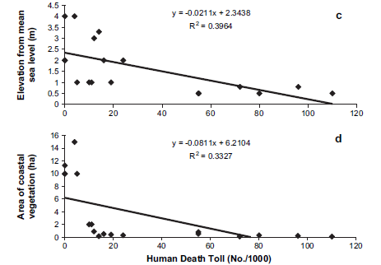
Impact also studied in coastal India
Kathiresan & Rajendran 2005

Slide 12
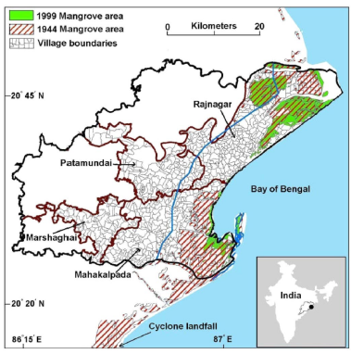
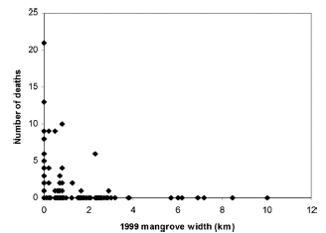
Protection from cyclone effects
Das & Vincent 2009 PNAS 106: 7357-7360

Slide 13
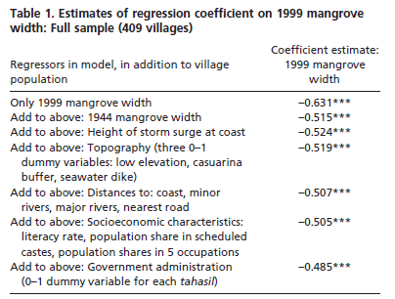
Das & Vincent – statistically evaluated competing hypotheses

